Slide 1

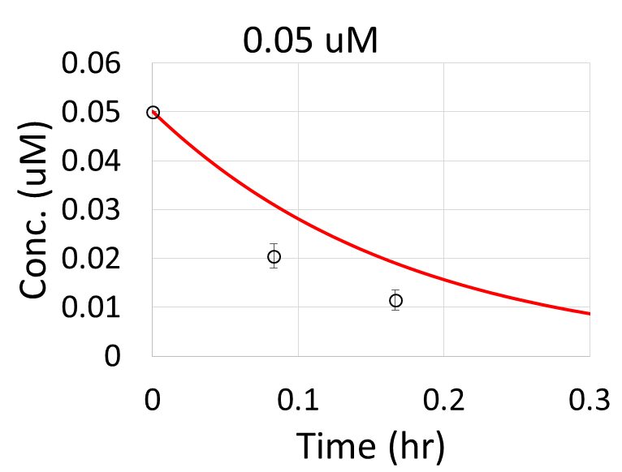
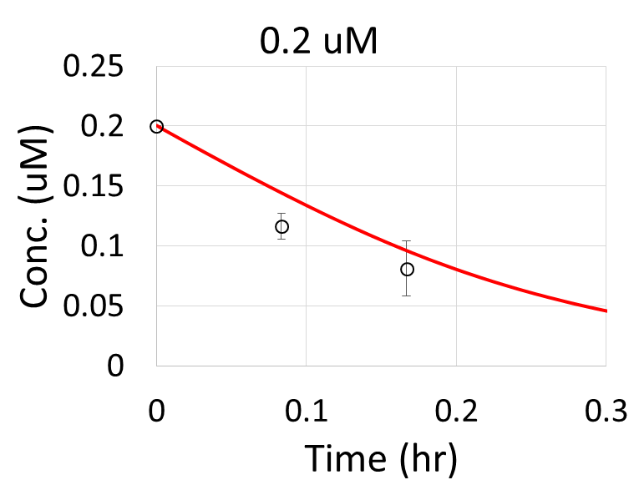
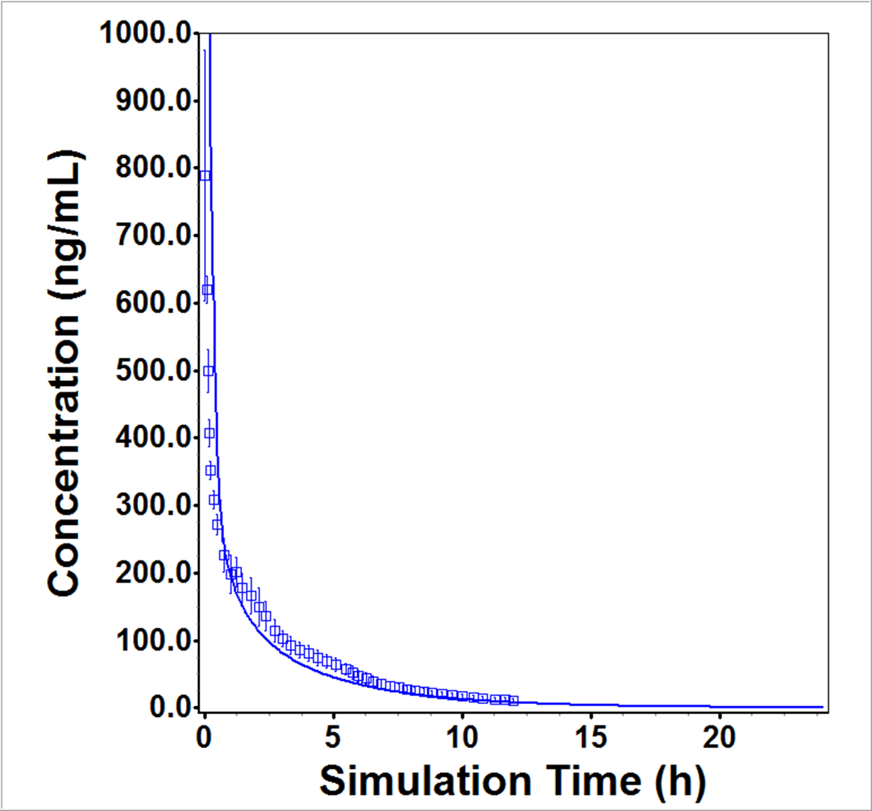
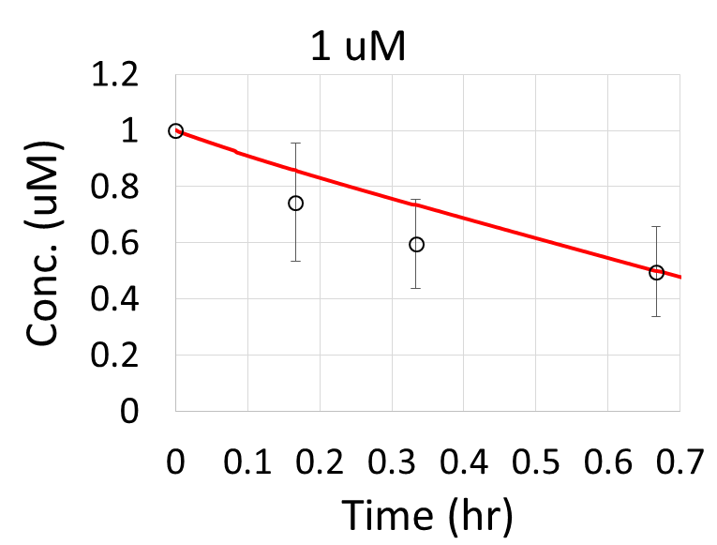
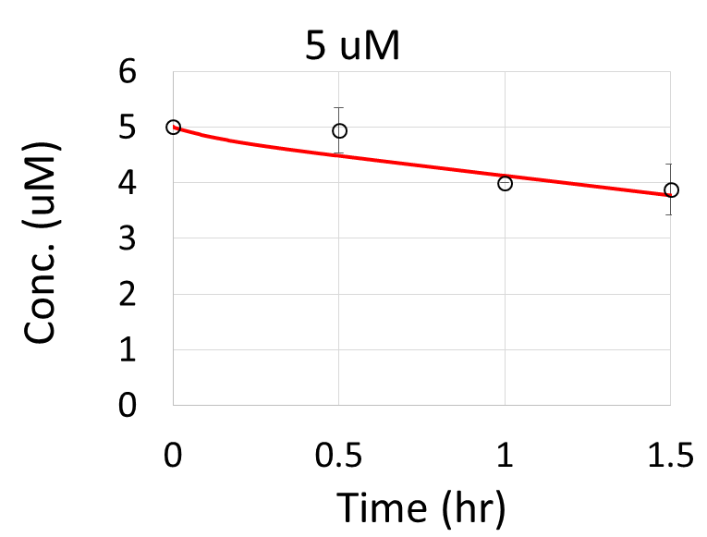
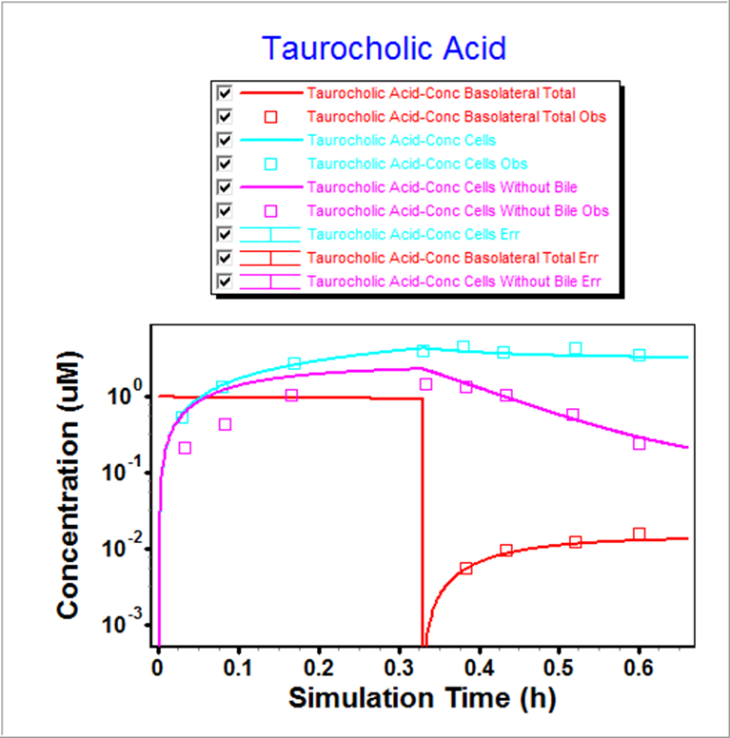
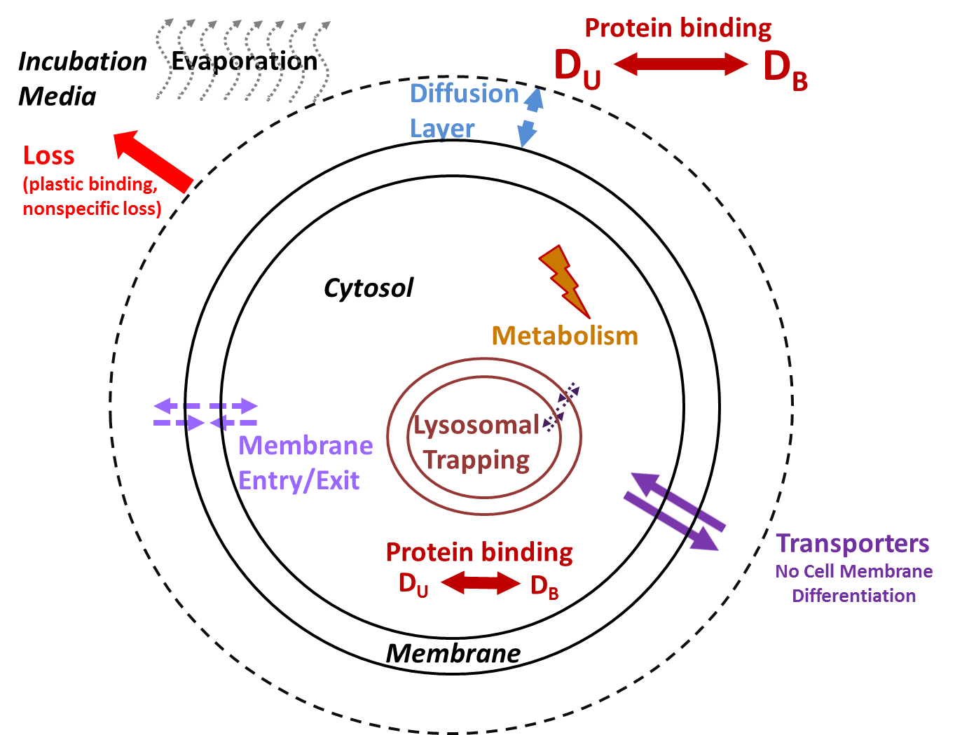
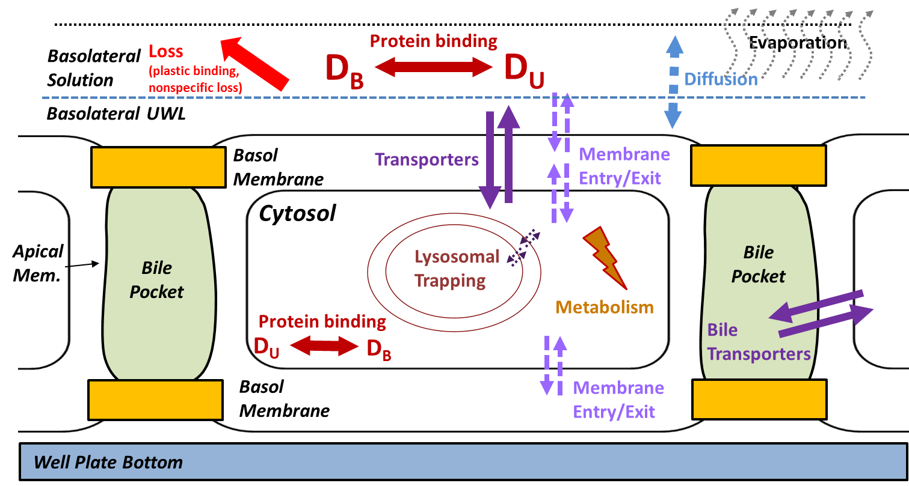

Poster T4077
Modeling of Active Transport and Metabolism for Hepatocyte Assays with Application of In Vitro to In Vivo Extrapolation (IVIVE)
James Mullin¹, Viera Lukacova¹, Walter S. Woltosz¹, Michael B. Bolger¹
¹Simulations Plus, Inc.
QR Code Only
QR Code
CONTACT INFORMATION: jim@simulations-plus.com, Simulations Plus, Inc., 42505 10th Street West, Lancaster, CA 93534
PURPOSE
Sandwich and suspended hepatocyte cultures are routinely used to assess either active transport and/or metabolism of drug molecules. In vitro assays that evaluate critical drug clearance and metabolism pathways are important in the prediction of hepatobiliary transport, drug-drug interactions, drug induced liver injury (DILI), and the relative importance between active transport and metabolism in hepatocytes. Physiologically based pharmacokinetic (PBPK) models provide quantitative in vivo simulation of drug disposition and drug-drug interactions if Km and Vmax values for the relevant transporters or enzymes can be extracted accurately from in vitro data. To that end, a fully mechanistic simulation of drug transport in both sandwich and suspended hepatocytes was developed in MembranePlus™ (Simulations Plus, Inc.) that allows simultaneous determination of Km and Vmax values for enzymes as well as both influx and efflux transporters. Both models account for additional processes such as drug diffusion through the unstirred boundary layer, sample volume loss, protein binding in both media and cytosol, lysosomal trapping, and drug partitioning into lipid bilayers. Two case studies are presented to demonstrate the applicability of these models. The active uptake and biliary secretion of sodium taurocholate is simulated in the sandwich hepatocyte model. The CYP2D6 metabolism of propafenone is evaluated in the suspended hepatocyte model and, in conjunction with a PBPK model, is used to predict the in vivo exposure.
Methods (Cont.)
Results
Results (Cont.)
Blood Flow
OSTα/β
Hepatocyte
The Km values are shown in Table 3. ADMET Predictor™ 8.0 (Simulations Plus, Inc.) was used to determine physicochemical properties and passive membrane transport parameters for each case study as shown in Table 2. The suspended hepatocyte model was used to predict passive diffusion and CYP2D6 metabolism of propafenone across 4 dose levels from 0.05 to 5 μM. Experimental data for media, cell, bile concentrations, or plasma concentrations, as well as, in vitro experimental settings (Table 1) in these systems was obtained from literature data.^{1,2,3}
BSEP
Bile Acids
Bile Pocket
Blood Flow
NTCP
Bile Acids
Figure 2. Schematic of sodium taurocholate uptake
Table 2. Properties of sodium taurocholate and propafenone for simulations in MembranePlus and GastroPlus
Table 1. Cell assay parameters for MembranePlus simulations
Cell Assay Inputs | Na. Taur. | Propafenone
Feed Solution Conc. | 1 | 0.05, 0.2, 1, 5 | μM
Protein in Basolateral Fluid (BSA) | 4 | NA | %
Well size | 24 | 6 | well
Volume | 0.3 | 2 | mL
Cell Volume | 6.46 | NA | pL
Cell Thickness/Diameter | 18.6 | 16.79 | micron
Cell Density | 0.4 | 1 | Mcell/well
Property | Na. Taur. | Propafenone
S+Sw (mg/mL) @ pH | 0.0184 @ pH 2.78 | 0.49 @ pH 10.28
S+pKa (Base) | 1.1 | 9.47
S+SF | 906 | 114
S+logP | 0.82 | 3.03
S+Peff (x10-4 cm/s) | 0.36 | 1.76
DiffCoef (x10-5 cm/s) | 0.53 | 0.65
Rbp | 0.59 | 0.81
Fu plasma | 16.8 | 19.03
ObjectiveS
Determine intracellular Km/Vmax values for metabolism in suspended hepatocyte cell culture.
To facilitate the generation of metabolism inputs for GastroPlus™ (Simulations Plus, Inc.).
Calculate the biliary transport and disposition of sodium taurocholate.
Figure 4. Km/Vmax fitting results for propafenone in suspended hepatocyte culture (left)
Figure 5. GastroPlus IVIVE prediction of 70 mg IV bolus dose in human (right)
Conclusion
The sandwich and suspended hepatocyte models within MembranePlus are new utilities for scientists to analyze their in vitro experiments and extract relevant Km and Vmax parameters for active transport and metabolism. We have shown that the models and parameters extracted from MembranePlus can then be utilized in a PBPK model to predict in vivo exposure. In the future, we will expand the capabilities of the new hepatocyte models to determine relevant in vitro drug-drug interaction parameters for predictions of in vivo DDI potential.
Methods
The mechanistic models for transport and metabolism in sandwich and suspended hepatocytes were implemented in MembranePlus version 2 and are shown in Figure 1.
In sandwich hepatocyte cells, Vmax values of 0.0404, 0.0863, and 0.0737 μmol/s/L cytosol were obtained for NTCP (influx), BSEP (bile efflux), and OSTa/b (efflux) transport of sodium taurocholate. The fitted concentration profiles and Vmax values are shown in Figure 3 and Table 3, respectively. The resulting prediction of media and cell concentration including bile had a mean absolute error of 13.6%. The accuracy figure encompasses both the uptake and efflux (or wash) phase where the cells are exposed to drug-free buffer. In suspended hepatocytes, Km and Vmax values of 0.0146 μM and 0.0927 μmol/s/L cytosol were obtained for the CYP2D6 metabolism of propafenone and the fitted predictions are shown in Figure 4. The resulting parameters were used in the GastroPlus PBPK model to predict propafenone PK as shown in Figure 5. The IVIVE was reasonably accurate with a predicted and observed AUC of 1343 and 1032 ng-hr/mL (23% error). The result indicates that the metabolic clearance predictions obtained from MembranePlus analysis of in vitro data and the Lukacova method for tissue partition coefficients are an acceptable combination in this case and show the utility of both software tools for IVIVE.
Suspended Hepatocytes
Sandwich Hepatocytes
Efflux Phase
REFERENCE
1. Guo, Cen, et al. ISSX (2014).
2. Komura, Hiroshi, et al., Drug metabolism and disposition 33.6 (2005): 726-732.
3. Schlepper and Olsson, Cardiac Arrhythmias, Springer-Verlag (1983): 125-132.
4. Swift, et al., Molecular Pharmaceutics 7.2 (2009): 491-500.
5. St-Pierre, et al., Journal of Experimental Biology 204.10 (2001): 1673-1686.
Figure 1. Physical model for drug transport in suspended hepatocytes (left) and sandwich hepatocytes (right).
Figure 3. Model results for extraction of Vmax values. For biliary excretion of sodium taurocholate
The partial differential equations that describe drug transport are solved using the method of lines in rectangular or spherical 1D geometries. The sandwich hepatocyte model was utilized to determine the Vmax for active uptake and efflux of sodium taurocholate as shown in Figure 2. Because disposition data was only measured at one dose concentration, (1 μM) Km values for MRP4, OSTα/β, and BSEP mediated transport of sodium taurocholate could not be fitted and were used as obtained from literature^{4,5}.
Table 3. Fitted Vmax values for sodium taurocholate disposition in sandwich hepatocytes
Transporter | K_{m} Exp (μM) | V_{max} Fit (μmol/s/L) | K_{m} Literature Source
BSEP | 25.8 | 6.83E-03 | Swift-Mol-Pharm-2010-7(2)-491–500
OSTa/b | 6 | 9.63E-02 | J-Exp-Biol-2001-204-1673-1686
NTCP | 5 | 3.88E-02 | J-Exp-Biol-2001-204-1673-1686

