Slide 1

Earnings Call: Q4 - FY25
December 1, 2025

Slide 2
Safe Harbor Statement
Except for historical information, the matters discussed in this presentation are forward-looking statements that involve risks and uncertainties. Words like “believe,” “will”, “can”, “expect,” “anticipate” and similar expressions (or the negative of such terms, as well as other words or expressions referencing future events, conditions or circumstances) mean that these are our best estimates as of this writing, but there can be no assurances that expected or anticipated results or events will actually take place, so our actual future results could differ significantly from those statements. Factors that could cause or contribute to such differences include, but are not limited to: effectiveness of our new operational structure, our ability to maintain our competitive advantages and commercialize AI and cloud-enabled solutions, evolving regulatory and data privacy standards governing AI technologies, acceptance of new software and improved versions of our existing software by our customers, the general economics of the pharmaceutical industry, our ability to finance growth, our ability to continue to attract and retain highly qualified technical staff, market conditions, macroeconomic factors, and a sustainable market. Further information on our risk factors is contained in our quarterly, annual and current reports and filed with the U.S. Securities and Exchange Commission.
Non-GAAP Financial Measures
This press release includes certain financial measures not presented in accordance with generally accepted accounting principles (“GAAP”) such as Adjusted EBITDA, Adjusted EBITDA Margin, Adjusted Net Income, and Adjusted Diluted EPS and certain ratios and other metrics derived there from. These non-GAAP financial measures are not measures of financial performance in accordance with GAAP and may exclude items that are significant in understanding and assessing financial results. Therefore, these measures should not be considered in isolation or as an alternative to net income, cash flows from operations or other measures of profitability, liquidity or performance under GAAP. You should be aware that the presentation of these measures may not be comparable to similarly-titled measures used by other companies. We believe (i) these non-GAAP measures of financial results provide useful information to management and investors regarding certain financial and business trends; and (ii) that the use of these non-GAAP financial measures provides an additional tool for investors to use in evaluating ongoing operating results and trends in and in comparing financial measures with other similar companies, many of which present similar non-GAAP financial measures to investors. These non-GAAP financial measures are subject to inherent limitations as they reflect the exercise of judgments by management about which expense and income are excluded or included in determining these non-GAAP financial measures. Reconciliations of these non-GAAP measures to the most directly comparable GAAP measures are set forth in the appendix to this presentation.

Slide 3
Fourth Quarter 2025 Highlights
Current period
$17.5M
-6%
($0.03)
$0.10
20%
Revenue
Revenue Decline
Diluted EPS
Adj.
Diluted EPS
Adj. EBITDA Margin
Prior Year Comparison (FY24)
$18.7M Revenue
+19%
$0.04
Diluted EPS
$0.18
22%
Adj. EBITDA Margin
Revenue
Growth
Adj.
Diluted EPS

Slide 4
Full year 2025 Highlights
Current period
$79.2M
+13%
($3.22)
$1.03
28%
Revenue
Revenue Growth
Diluted EPS ⁽¹⁾
Adj.
Diluted EPS
Adj. EBITDA Margin
Prior Year Comparison (FY24)
$70.0M Revenue
+18%
Revenue
Growth
$0.49
Diluted EPS
$0.95
29%
Adj. EBITDA Margin
Adj.
Diluted EPS
⁽¹⁾ Diluted EPS includes a non-cash impairment charge of $77.2 million

Slide 5


Software Highlights
General
Overall software revenue decline of 9% for 4Q25 and 12% growth for full year
Renewal rates impacted by client consolidations and site closures
ADMET Predictor®
DISCOVERY
GastroPlus®
DEVELOPMENT
MonolixSuite™
DEVELOPMENT
QSP/QST Software
DEVELOPMENT
Pro-ficiency®
CLINICAL OPS
-10%
-3%
+3%
+22%
-63%
Q4 Revenue Decline
Q4 Revenue Decline
Q4 Revenue Growth
Q4 Revenue Growth
Q4 Revenue Decline
$18.7M Revenue
+19%
Revenue
Growth
$0.04
Diluted EPS
$0.18
Adj. Diluted EPS
22%
Adj. EBITDA Margin
+5%
+1%
+14%
+26%
+206%
FY Revenue Growth
FY Revenue Growth
FY Revenue Growth
FY Revenue Growth
FY Revenue Growth

Slide 6

Services Highlights
General
Overall services revenue decline of 3% for 4Q25 and revenue growth of 15% for FY25
Total backlog $18.0M, over 91% expected to be converted to revenue within 12 months
PBPK Services
DEVELOPMENT
PKPD Services
DEVELOPMENT
QSP/QST Services
DEVELOPMENT
Med Comm Services
COMMERCIALIZATION
-10%
+18%
-50%
+70%
Q4 Revenue Decline
Q4 Revenue Growth
Q4 Revenue Decline
Q4 Revenue Growth
$18.7M Revenue
+19%
Revenue
Growth
$0.04
Diluted EPS
$0.18
Adj. Diluted EPS
22%
Adj. EBITDA Margin
-14%
+5%
-26%
+622%
FY Revenue Decline
FY Revenue Growth
FY Revenue Decline
FY Revenue Growth

Slide 7

Financial Results
$18.7M Revenue
+19%
Revenue
Growth
$0.04
Diluted EPS
$0.18
Adj. Diluted EPS
22%
Adj. EBITDA Margin

Slide 8
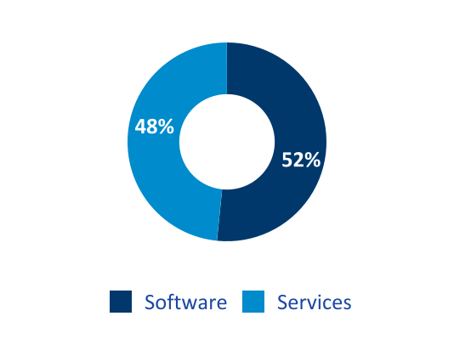
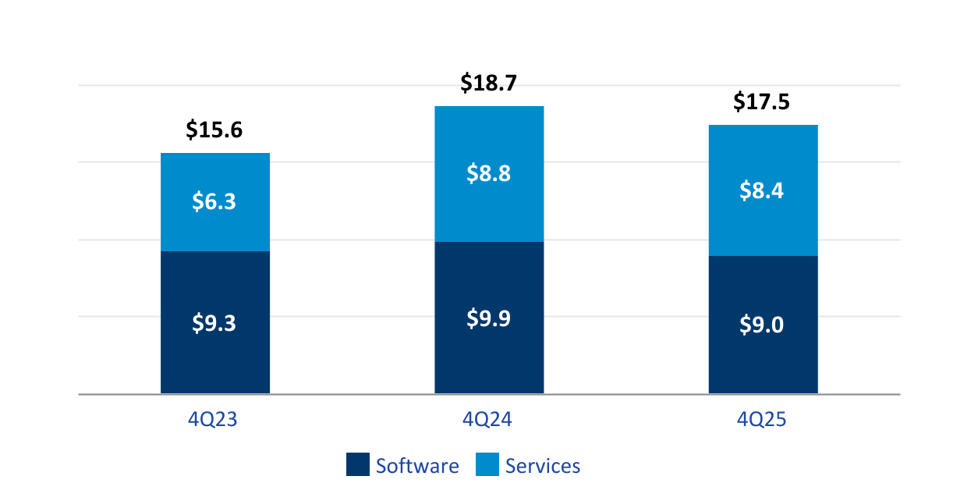
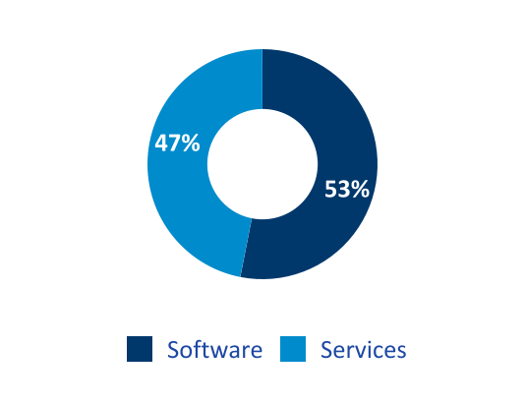
Revenue - Q4 FY25
(in millions)
4Q25 Mix
-6%
-9%
-3%
Total Revenue Decline
Software Revenue Decline
Services Revenue Decline
4Q24 Mix

Slide 9
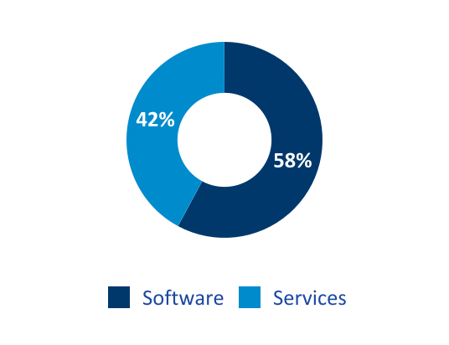
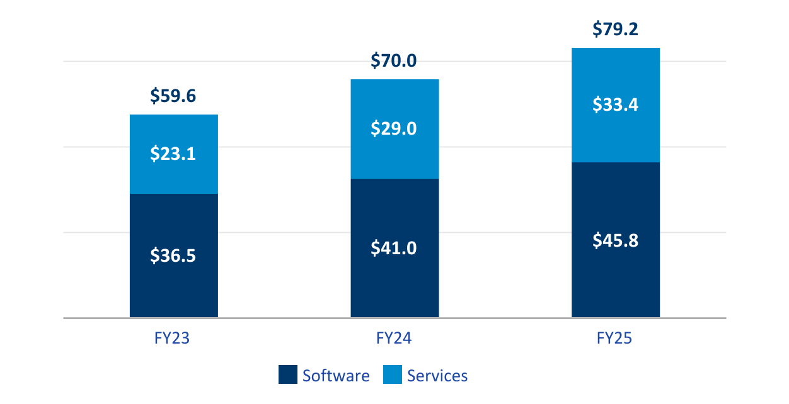

Revenue - Fiscal 2025
(in millions)
FY25 Mix
+13%
+12%
+15%
Total Revenue Growth
Software Revenue Growth
Services Revenue Growth
FY24 Mix

Slide 10
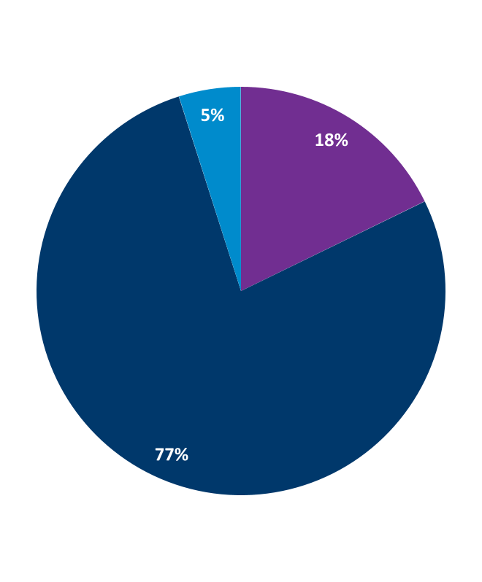
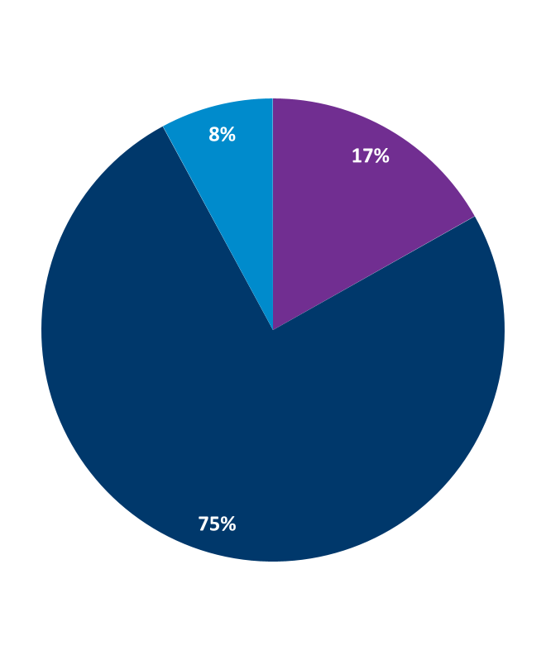
Software Solutions as % of Software Revenue
4Q25
FY25
Fourth Quarter Highlights
Discovery
ADMET Predictor®
9 new clients
5 upsells to existing clients
Development
GastroPlus®
11 new clients
8 upsells to existing clients
MonolixSuite™
7 new clients
5 upsells to existing clients
Discovery
Discovery
Development
Development
Clinical Ops
Clinical Ops

Slide 11
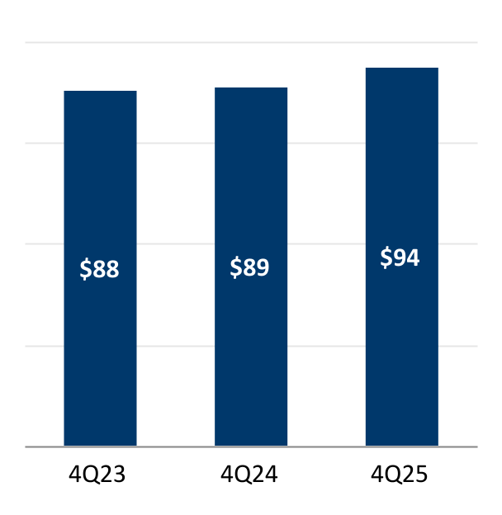
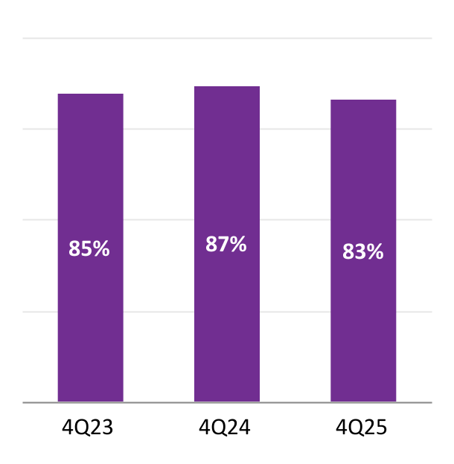
Software Performance Metrics - Q4 FY25
Commercial Clients
Avg. Revenue per Client
(in thousands)
Renewal Rate
(fee based)

Slide 12
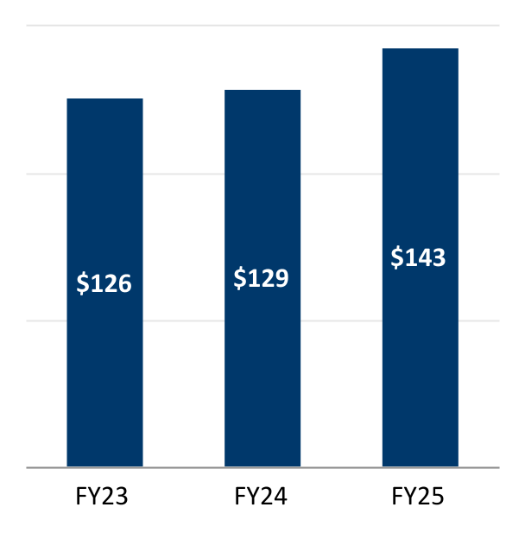
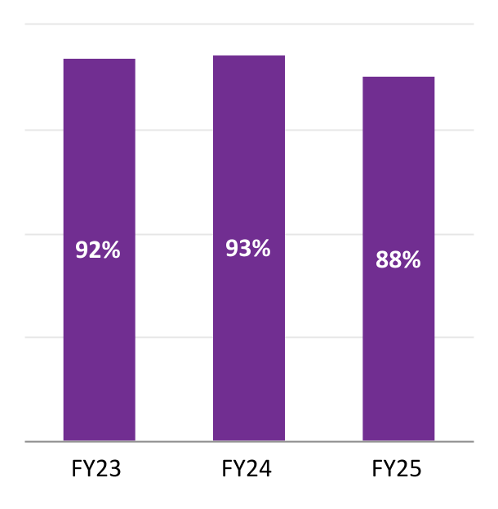
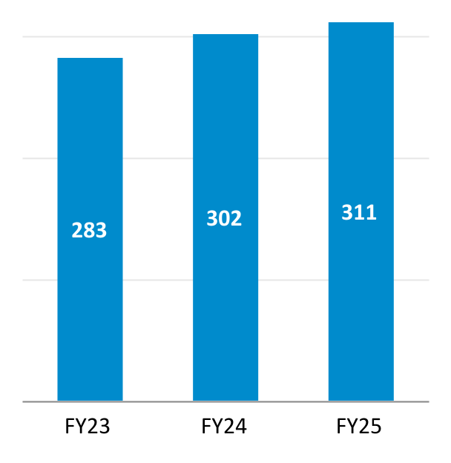
Software Performance Metrics - Fiscal 2025
Commercial Clients
Avg. Revenue per Client
(in thousands)
Renewal Rate
(fee based)
Clients
(end of period)

Slide 13
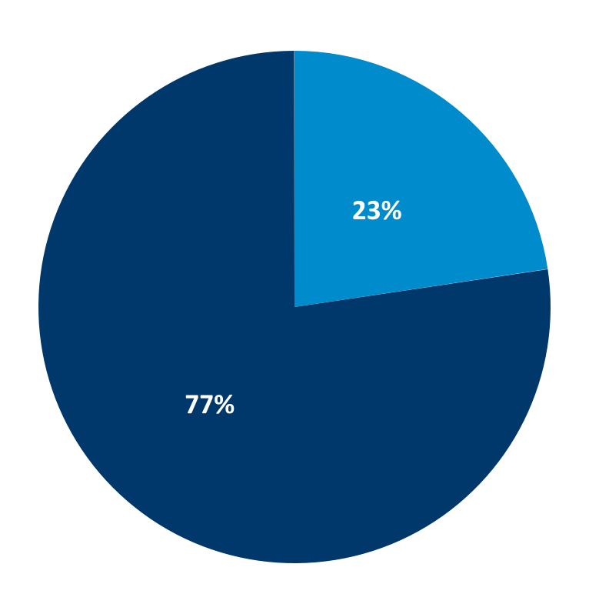
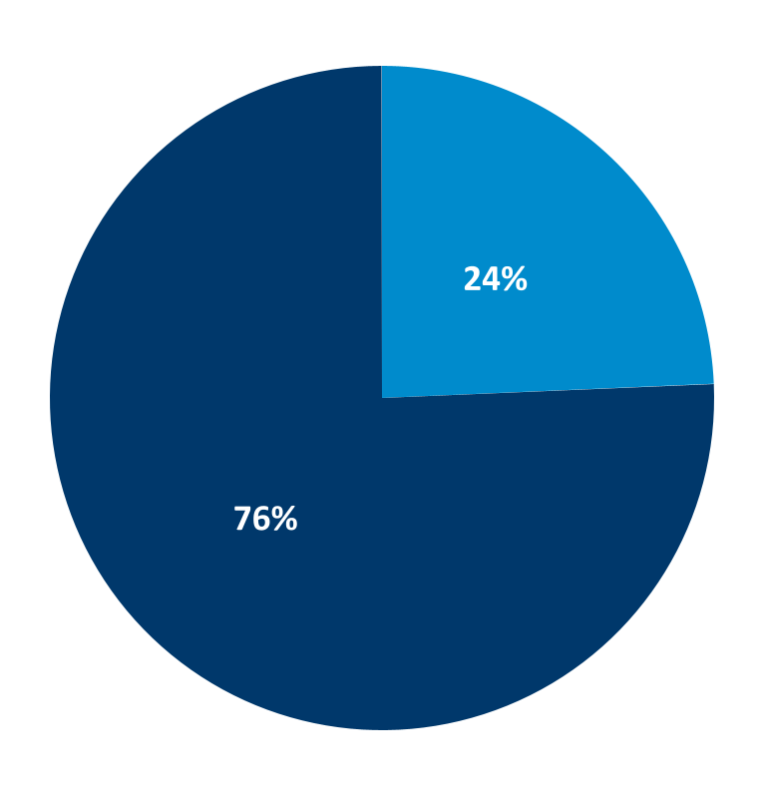
Services Solutions as % of Services Revenue
4Q25
FY25
Development
Development
Commercialization
Commercialization

Slide 14
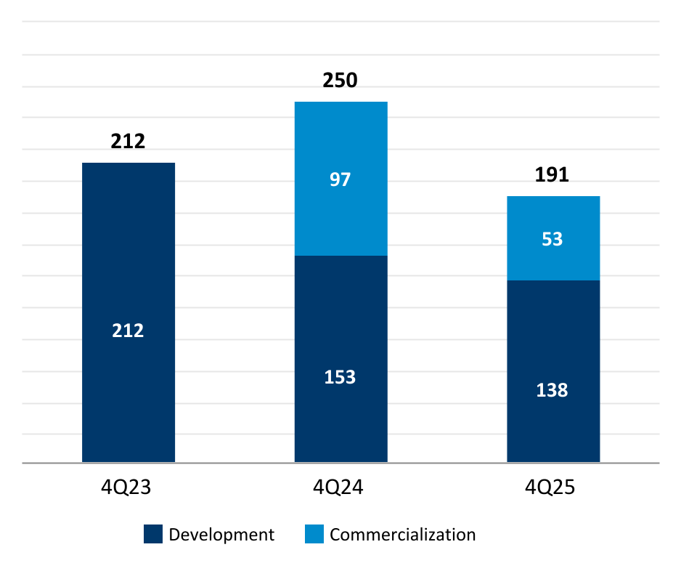
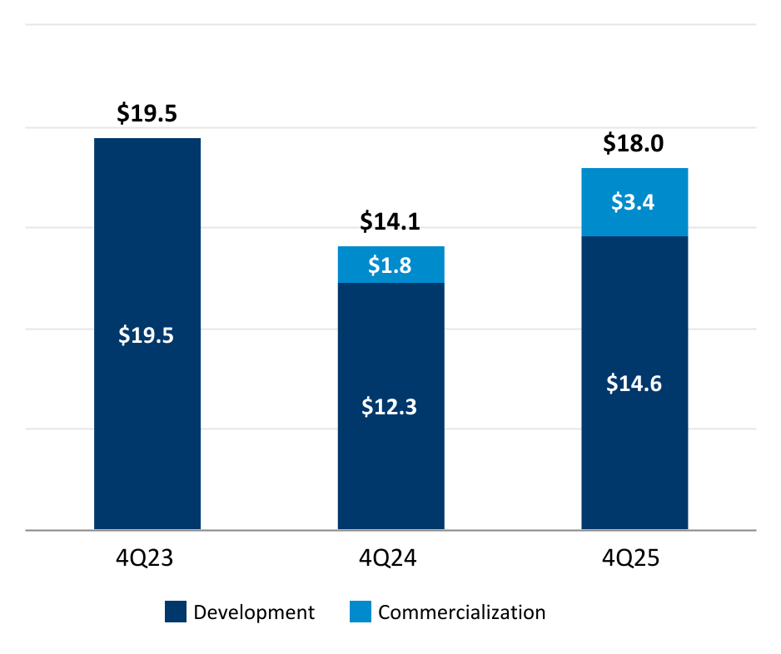
Services Performance Metrics
Total Projects
Backlog (in millions)

Slide 15
Income Statement Summary - Q4 FY25 ⁽¹⁾
(in millions, except Diluted EPS and Adjusted Diluted EPS)
 | 4Q25 | % of Rev | 4Q24 | % of Rev
Revenue | $17.5 | 100% | $18.7 | 100%
Cost of revenue | 7.6 | 44% | 11.8 | 63%
Gross profit | 9.8 | 56% | 6.8 | 37%
R&D | 1.7 | 10% | 1.9 | 10%
S&M | 2.7 | 15% | 2.6 | 14%
G&A excluding nonrecurring | 4.8 | 27% | 1.8 | 9%
Nonrecurring | 0.1 | —% | 1.7 | 9%
Total operating expense | 9.2 | 53% | 8.0 | 43%
Income (loss) from operations | 0.7 | 4% | (1.2) | (6%)
Income before income taxes | 0.9 | 5% | 0.9 | 5%
Income tax benefit | (1.6) | (9%) | — | —%
Net (loss) income | ($0.7) | (4%) | $0.8 | 5%
Diluted EPS | ($0.03) |  | $0.04
Adjusted EBITDA | $3.5 | 20% | $4.1 | 22%
Adjusted Diluted EPS | $0.10 |  | $0.18
⁽¹⁾ Numbers may not add due to rounding

Slide 16
Income Statement Summary - Fiscal 2025 ⁽¹⁾
(in millions, except Diluted EPS and Adjusted Diluted EPS)
 | FY25 | % of Rev | FY24 | % of Rev
Revenue | $79.2 | 100% | $70.0 | 100%
Cost of revenue | 33.0 | 42% | 26.9 | 38%
Gross profit | 46.2 | 58% | 43.2 | 62%
R&D | 6.9 | 9% | 5.8 | 8%
S&M | 11.9 | 15% | 8.9 | 13%
G&A excluding nonrecurring | 19.5 | 25% | 19.7 | 28%
Nonrecurring | 78.7 | 99% | 2.6 | 4%
Total operating expense | 117.0 | 148% | 37.0 | 53%
(Loss) income from operations | (70.7) | (89%) | 6.1 | 9%
(Loss) income before income taxes | (69.4) | (88%) | 12.4 | 18%
Income tax benefit (expense) | 4.7 | 6% | (2.5) | (4%)
Net (loss) income | ($64.7) | (82%) | $10.0 | 14%
Diluted EPS | ($3.22) |  | $0.49
Adjusted EBITDA | $22.0 | 28% | $20.3 | 29%
Adjusted Diluted EPS | $1.03 |  | $0.95
⁽¹⁾ Numbers may not add due to rounding

Slide 17
Balance Sheet Summary ⁽¹⁾
(in millions)
 | August 31, 2025 | August 31, 2024
Cash and short-term investments | $32.4 | $20.3
Other current assets | 19.2 | 19.1
Long term assets | 80.4 | 157.3
Total assets | $131.9 | $196.6
Current liabilities | 6.7 | 12.1
Long-term liabilities | 0.4 | 2.1
Total liabilities | 7.1 | 14.2
Shareholders’ equity | 124.8 | 182.4
Total liabilities and shareholders’ equity | $131.9 | $196.6
⁽¹⁾ Numbers may not add due to rounding

Slide 18
Fiscal 2026 Guidance
Guidance
Total Revenue | $79M - $82M
Total Revenue Growth | 0% - 4%
Software Revenue Mix | 57% - 62%
Adjusted EBITDA ⁽¹⁾ Margin | 26% - 30%
Adjusted Diluted EPS ⁽²⁾ | $1.03 - $1.10
⁽¹⁾ Adjusted EBITDA represents net income excluding the effect of interest expense (income), provision (benefit) for income taxes, depreciation and amortization, equity-based compensation expense, loss (gain) on currency exchange, impairment charges, change in fair value of contingent consideration, reorganization expense, acquisition and integration expense and other items not indicative of our ongoing operating performance.
⁽²⁾ Adjusted net income and adjusted diluted earnings per share exclude the effect of amortization, equity-based compensation expense, loss (gain) on currency exchange, impairment charges, change in fair value of contingent consideration, reorganization expense, acquisition and integration expense and other items not indicative of our ongoing operating performance as well as the income tax provision adjustment for such charges.

Slide 19
Adjusted EBITDA Non-GAAP Reconciliation ⁽¹⁾
(in thousands)
 | 4Q25 | 4Q24 | FY25 | FY24
Net (loss) income | ($681) | $843 | ($64,718) | $9,954
Excluding:
Interest income and expense, net | (239) | (213) | (722) | (4,375)
Provision for income taxes | 1,570 | 20 | (4,659) | 2,457
Depreciation and amortization | 1,354 | 2,206 | 8,211 | 5,665
Stock-based compensation | 1,389 | 1,387 | 5,814 | 5,940
(Gain) loss on currency exchange | 9 | (431) | (13) | (386)
Impairments | — | — | 77,221 | —
Loss from disposal of fixed assets | — | — | 23 | —
Change in value of contingent consideration | — | (1,370) | (640) | (1,639)
Reorganization expense | 202 | — | 1,462 | —
Mergers & Acquisitions expense | (142) | 1,706 | (9) | 2,641
Adjusted EBITDA | $3,462 | $4,148 | $21,970 | $20,257
⁽¹⁾ Numbers may not add due to rounding

Slide 20
Adjusted Diluted EPS Non-GAAP Reconciliation ⁽¹⁾
(in thousands, except Diluted EPS and Adjusted Diluted EPS)
 | 4Q25 | 4Q24 | FY25 | FY24
Net (loss) Income | ($681) | $843 | ($64,718) | $9,954
Excluding:
Amortization | 1,242 | 2,059 | 7,667 | 5,163
Stock-based compensation | 1,389 | 1,387 | 5,814 | 5,940
(Gain) loss on currency exchange | 9 | (431) | (13) | (386)
Mergers & Acquisitions expense | (142) | 1,706 | (9) | 2,641
Change in value of contingent consideration | — | (1,370) | (640) | (1,639)
Reorganization expense | 202 | — | 1,462 | —
Impairments | — | — | 77,221 | —
Loss from disposal of fixed assets | — | — | 23 | —
Tax effect on above adjustments | (27) | (554) | (6,146) | (2,320)
Adjusted Net income | $1,992 | $3,640 | $20,661 | $19,353
Diluted weighted-avg. common shares outstanding | 20,127 | 20,338 | 20,101 | 20,301
Diluted EPS | ($0.03) | $0.04 | ($3.22) | $0.49
Adjusted Diluted EPS | $0.10 | $0.18 | $1.03 | $0.95
⁽¹⁾ Numbers may not add due to rounding

Slide 21

Thank You
Investor Relations Contact:
Lisa Fortuna
Financial Profiles
slp@finprofiles.com | +1-310-622-8251

