Slide 1
Earnings Call - Q2 - FY23
April 5, 2023
1

Slide 2
Safe Harbor Statement
With the exception of historical information, the matters discussed in this presentation are forward-looking statements that involve a number of risks and uncertainties. Words like “believe,” “expect” and “anticipate” mean that these are our best estimates as of this writing, but that there can be no assurances that expected or anticipated results or events will actually take place, so our actual future results could differ significantly from those statements. Factors that could cause or contribute to such differences include, but are not limited to: our ability to maintain our competitive advantages, acceptance of new software and improved versions of our existing software by our customers, the general economics of the pharmaceutical industry, our ability to finance growth, our ability to continue to attract and retain highly qualified technical staff, our ability to identify and close acquisitions on terms favorable to the Company, and a sustainable market. Further information on our risk factors is contained in our quarterly and annual reports and filed with the U.S. Securities and Exchange Commission.

Slide 3
Second Quarter Highlights
$16M
$0.20
40%
$15M
Revenue
Diluted EPS
Adj. EBITDA as % of Revenue
Backlog
Second quarter results in line with guidance
Revenue seasonality impacted by expected shift in software renewal timing
Continue to see slower pace of sales cycles due to customer budget constraints
Churn in small biotech accounts
$0.2M constant currency negative impact on revenue
EPS ahead of guidance; EBITDA back to historical levels

Slide 4
Supporting Client Success
New AI/ML drug discovery collaborations
pKa collaboration with large agrochemicals company extending ML models
4 new FDA grant submissions
Critical PBPK service support to multiple clients
Supported multiple high profile regulatory submissions with pharmacometric modeling and simulation support
Initiated additional projects with investment groups following prior quarter success

Slide 5
Second Quarter Software Highlights
General
Overall software revenue growth of 7%
Renewal pattern and revenue seasonality shifting as anticipated
Slower pace of new sales with new customers delaying purchases
University+ program has 278 individual licenses across 54 countries
Good yield on price increase
GastroPlus®
+18%
-1%
Q2 Revenue Growth
6 new customers
6 upsells to existing customers
25 peer reviewed journal articles published in Q2
YTD Revenue Decline
MonolixSuite®
-8%
-5%
Q2 Revenue Decline
5 new customers
6 upsells to existing customers
Impacted by renewal harmonization and forex
YTD Revenue Decline
ADMET Predictor®
-2%
-12%
Q2 Revenue Decline
1 new customer
8 upsells to existing customers
Impacted by Biotech churn
YTD Revenue Decline

Slide 6
Second Quarter Services Highlights
General
Overall service revenue growth 4%
Total backlog $15.4M – projects to be performed within 12 months increased from 70% to 78%
Successful recruiting quarter despite continued competitive market (2 new hires)
188 total projects worked on during the quarter
PKPD
+19%
+21%
Q2 Revenue Growth
Shift to higher margin time and materials contracts vs fixed priced projects with positive margin impact
Multiple new client relationships
YTD Revenue Growth
QSP/QST
-32%
-30%
Q2 Revenue Decline
Nature of QSP/QST projects more volatile
Prior quarter included significant CRO pass through revenue
YTD Revenue Decline
PBPK
+29%
+50%
Q2 Revenue Growth
Reflects deeper implementation of PBPK modeling – expanding use cases and perceived value/impact
4 FDA projects in process
YTD Revenue Growth

Slide 7
Capital Allocation Strategy Update
Product R&D
Employee Recruiting and Retention
Enterprise Technologies
Acquisitions
Strategic investments and partnerships
Internal Investment
Corporate Development
Dividend Payments
Share Repurchases
Maintain current level
$0.06 per share paid Feb. 6th
$0.06 per share payable May 1st
$50M share repurchase program authorized
$20M accelerated share repurchase (ASR) implemented

Slide 8
Maintaining FY23 Guidance
Total Revenue $59.3M to $62.0M
Total Revenue Growth 10% to 15%
Software Revenue Mix 60% to 65%
Service Revenue Mix 35% to 40%
Diluted EPS $0.63 to $0.67

Slide 9
Financial Results

Slide 10
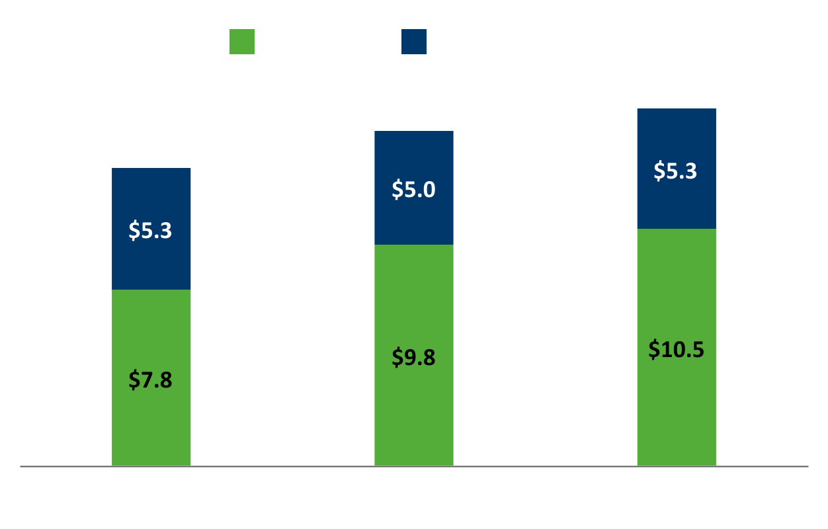
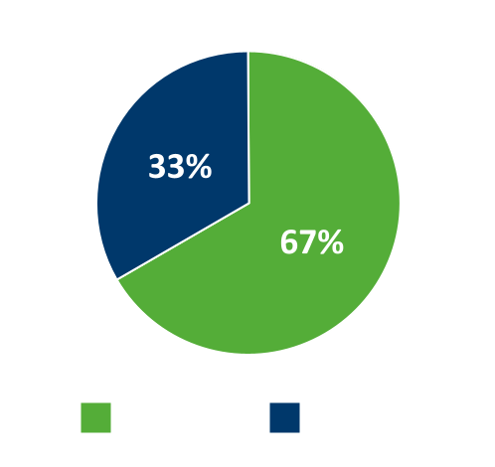
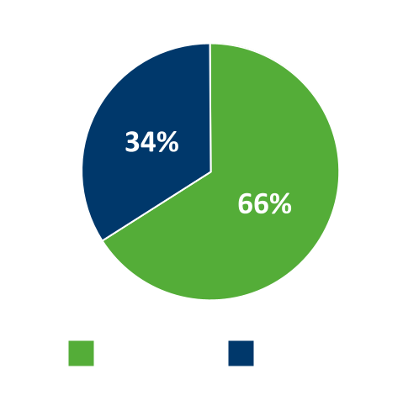
Q4 Revenue (in millions)
Revenue - Q2
(in millions)
2Q23 Mix
2Q22 Mix
+6%
+7%
+4%
Total Revenue
Software Revenue
Services Revenue

Slide 11
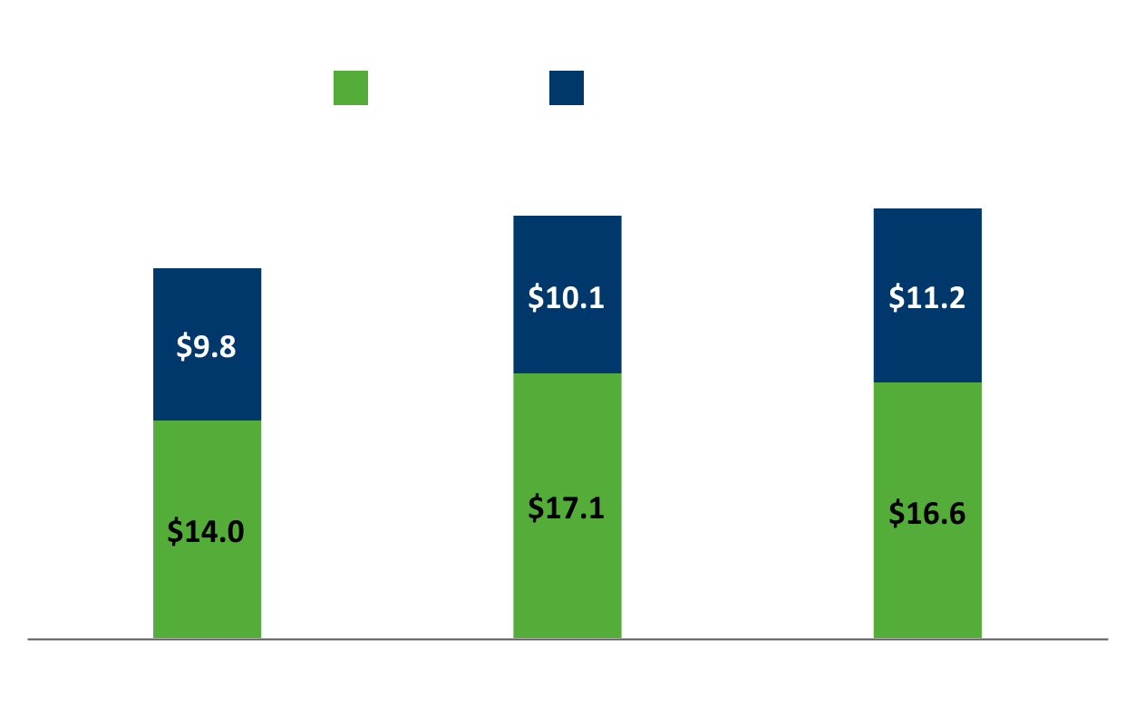
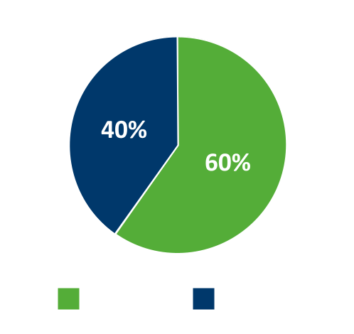
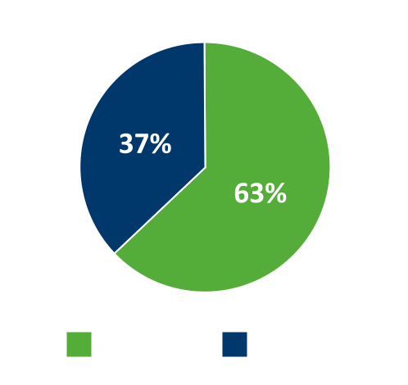
Q4 Revenue (in millions)
Revenue - YTD
(in millions)
FY23 Mix
FY22 Mix
+2%
-3%
+11%
Total Revenue
Software Revenue
Services Revenue

Slide 12
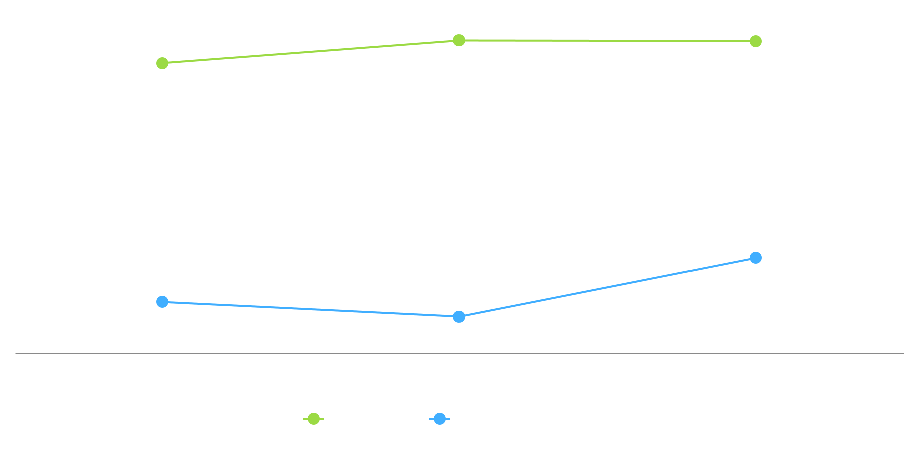
Gross Margin Trends - Q2

Slide 13
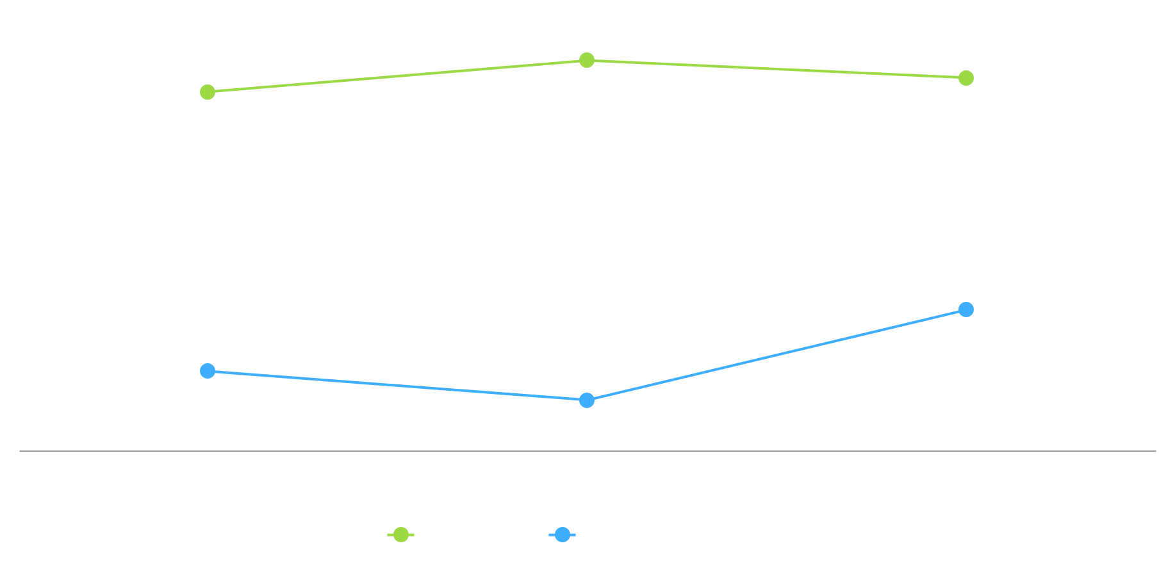
Gross Margin Trends - YTD

Slide 14
Software Revenue by Product
Q2 FY23
YTD FY23
Other
Other
Software Product as % of Software Revenue

Slide 15
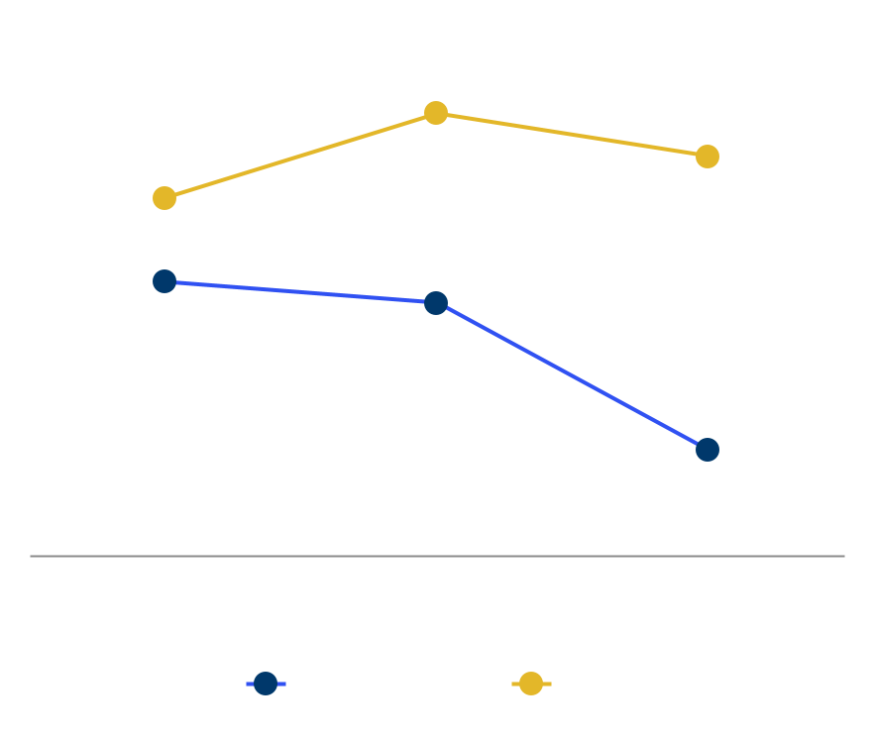
Software Performance Metrics - Q2
Commercial Customers
Avg. Revenue per Customer
(in thousands)
Renewal Rates

Slide 16
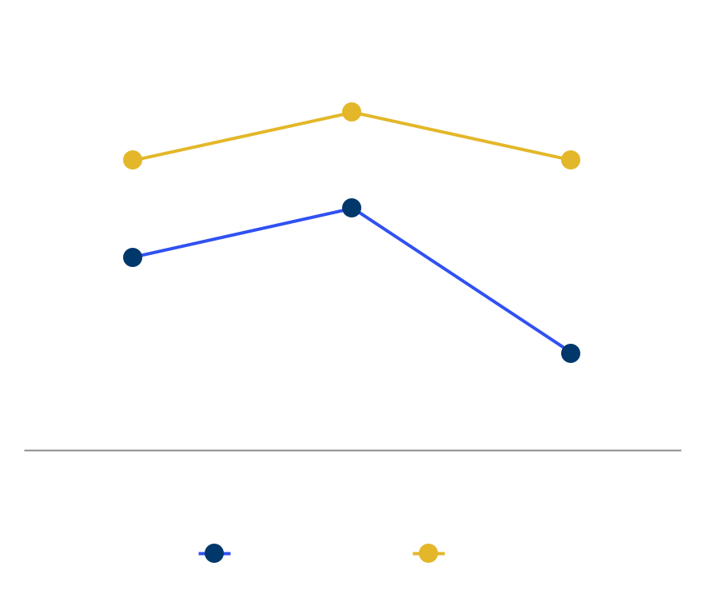
Software Performance Metrics - YTD
Commercial Customers
Avg. Revenue per Customer
(in thousands)
Renewal Rates
University+ Customers: 278 in 54 countries

Slide 17
Service Revenue by Type
Q2 FY23
YTD FY23
PKPD
PKPD
QSP/QST
QSP/QST
PBPK
PBPK
Other
Other
Services as % of Service Revenue

Slide 18
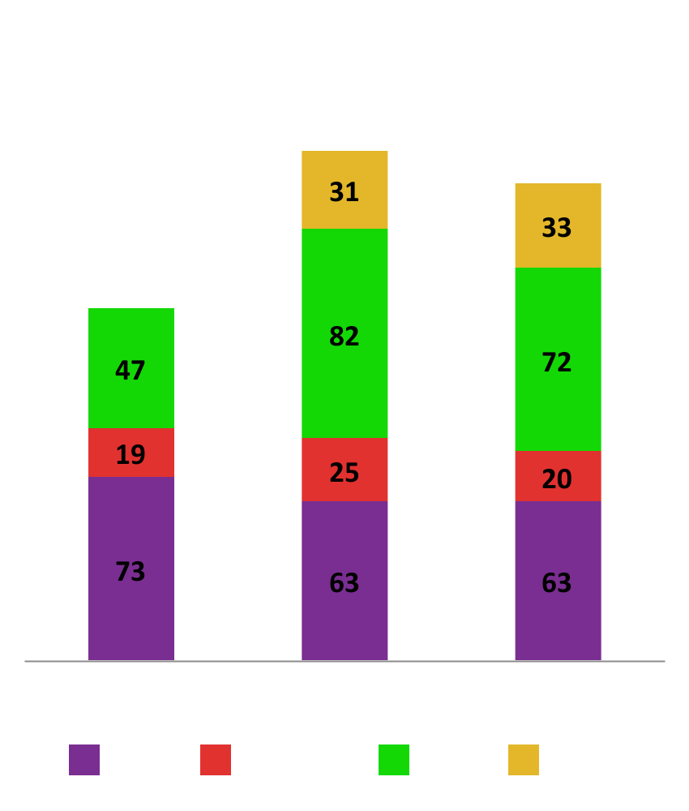
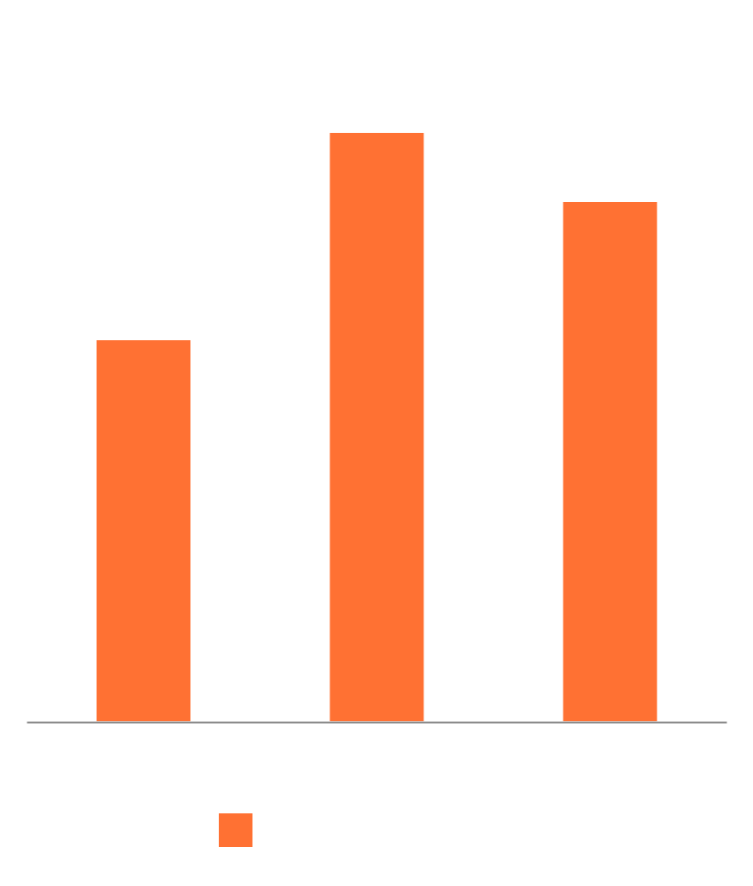
Services Performance Metrics
Total Projects
Backlog

Slide 19
Income Statement Summary - Q2
(in millions, except Diluted EPS)
 | 2Q23 | % of Rev | 2Q22 | % of Rev
Revenue | $15.8 | 100% | $14.8 | 100%
Revenue growth | 6% |  | 13%
Gross profit | 13.1 | 83% | 12.0 | 81%
R&D | 1.3 | 8% | 0.9 | 6%
SG&A | 7.8 | 49% | 5.6 | 38%
Total operating exp | 9.1 | 58% | 6.5 | 44%
Income from operations | 4.0 | 26% | 5.5 | 37%
Income before income taxes | 5.1 | 32% | 5.5 | 37%
Income taxes | (0.9) | 6% | (1.1) | 8%
Effective tax rate | 18% |  | 20%
Net income | $4.2 | 27% | $4.4 | 30%
Diluted earnings per share (in dollars) | 0.20 |  | 0.21
Adjusted EBITDA | $6.2 | 40% | $7.2 | 48%

Slide 20
Income Statement Summary - YTD
(in millions, except Diluted EPS)
 | 2Q23 | % of Rev | 2Q22 | % of Rev
Revenue | $27.7 | 100% | $27.2 | 100%
Revenue growth | 2% |  | 14%
Gross profit | 22.4 | 81% | 21.6 | 79%
R&D | 2.5 | 9% | 1.8 | 7%
SG&A | 15.0 | 54% | 10.6 | 39%
Total operating exp | 17.5 | 63% | 12.4 | 45%
Income from operations | 4.9 | 18% | 9.3 | 34%
Income before income taxes | 6.7 | 24% | 9.4 | 35%
Income taxes | (1.3) | 5% | (2.0) | 7%
Effective tax rate | 19% |  | 21%
Net income | $5.4 | 20% | $7.4 | 27%
Diluted earnings per share (in dollars) | 0.26 |  | 0.36
Adjusted EBITDA | $9.2 | 33% | $12.4 | 46%

Slide 21
Balance Sheet Summary
(in millions)
 | February 28, 2023 | August 31, 2022
Cash and short-term investments | $115.3 | $128.2
Total current assets | 131.5 | 146.8
Total assets | $173.2 | $188.4
Current liabilities | 6.0 | 7.7
Long-term liabilities | 2.6 | 2.4
Total liabilities | 8.6 | 10.1
Shareholders’ equity | 164.6 | 178.2
Total liabilities and shareholders’ equity | $173.2 | $188.4

Slide 22
Conclusion
CONTINUED LEADERSHIP POSITION IN BIOSIMULATION MARKET
Delivering on our commitment to scientific leadership
Internal R&D investment
Expanding industry and regulatory partnerships
MIDD+ – 3rd annual SLP sponsored conference
Enhancing our client facing capabilities
Growth and maturity of business development team
Focus on expanding our local coverage of EU market
Focus on supporting accelerated growth in distributor network
Challenges being addressed
Evolving seasonality due to software renewal timing changes
Small biotech churn
Continued competitive market for scientific talent
General market dynamics: inflation, recession & forex
Focus on Capital Allocation
ACR program near completion
WELL POSITIONED TO ACHIEVE OUR FY23 GOALS

